Slide 1


TRAVEL AND TOURISM
TRIP SPHERE
(MOBILE APPLICATION)
IMPACTECH-2K24
Team -2K154

Slide 2
1. TEAM MEMBERS
Roll Numbers | Name
2110030291 | Farhaan Ali
2110030295 | Venkata Suhas
2110030323 | Rama Kowshik
2110030412 | Yesashwini
2110030444 | Dhana Sree

Slide 3
2. INTRODUCTION
India, with its rich cultural tapestry, diverse landscapes, and centuries-old heritage, offers travellers a truly immersive and unforgettable experience.
In recent years, the number of travellers to various Indian tourist spots has ranged from around 10 to 15 million visitors per year.

Slide 4
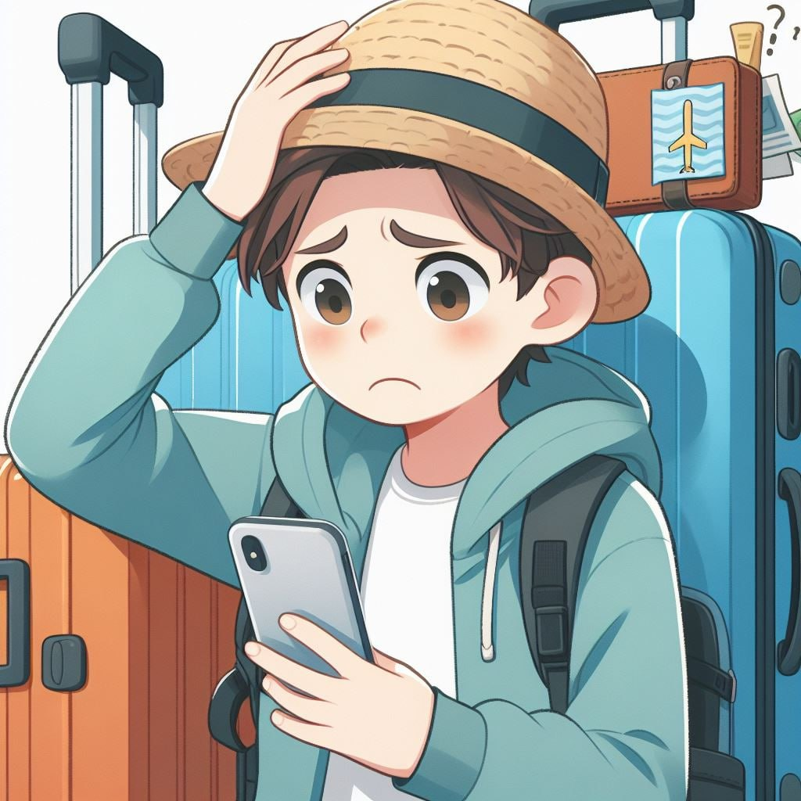
3. PROBLEM STATEMENT
Travelers today struggle with planning efficient trips due to three key limitations:
Many travellers struggle to find affordable transportation options to their desired destinations.
Lack of awareness about budget-friendly attractions and activities.
Limited access to information on dark tourism sites and their significance.
Existing platforms may not adequately address factors such as budget, time constraints, and personalized interests, leading to suboptimal travel experiences.

Slide 5

4. SOLUTION BREAKDOWN
Our tourism app is designed to enhance your travel experience by providing a comprehensive plan of action for your duration in a destination.
We provide the best routes possible where they can select the route based on their budget, time and interest.
Benefits:
Smart Budgeting.
Maximized Experience & Efficiency.
Discovery & Local Flavor.

Slide 6
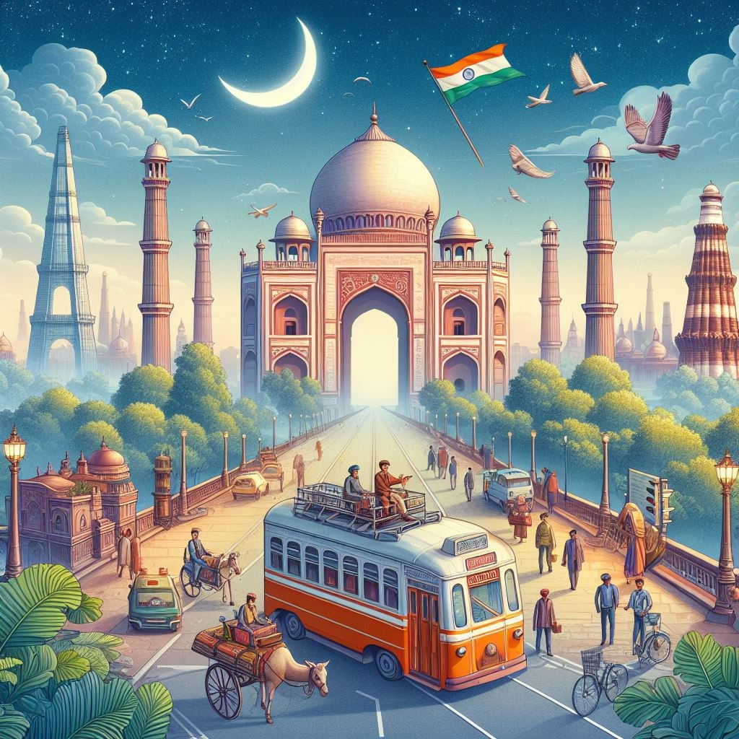
5. OUR SOLUTION IDEA
Our tourism app is designed to enhance your travel experience by providing a comprehensive plan of action for your duration in a destination.
We provide the best routes possible where they can select the route based on their budget, time and interest.

Slide 7
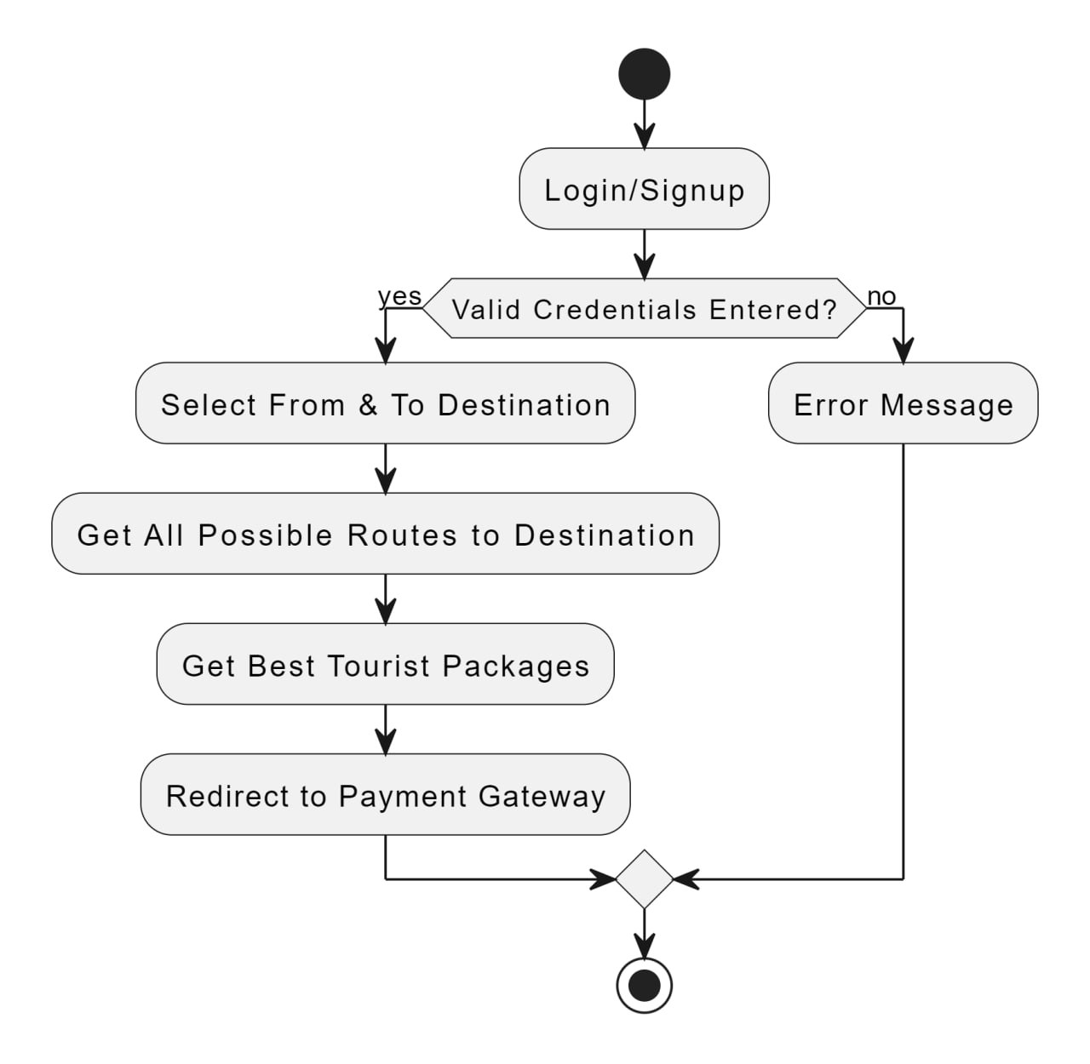
6. FEATURES
Available Routes
Dark Tourism
Tourism Packages
Audio Book

Slide 8
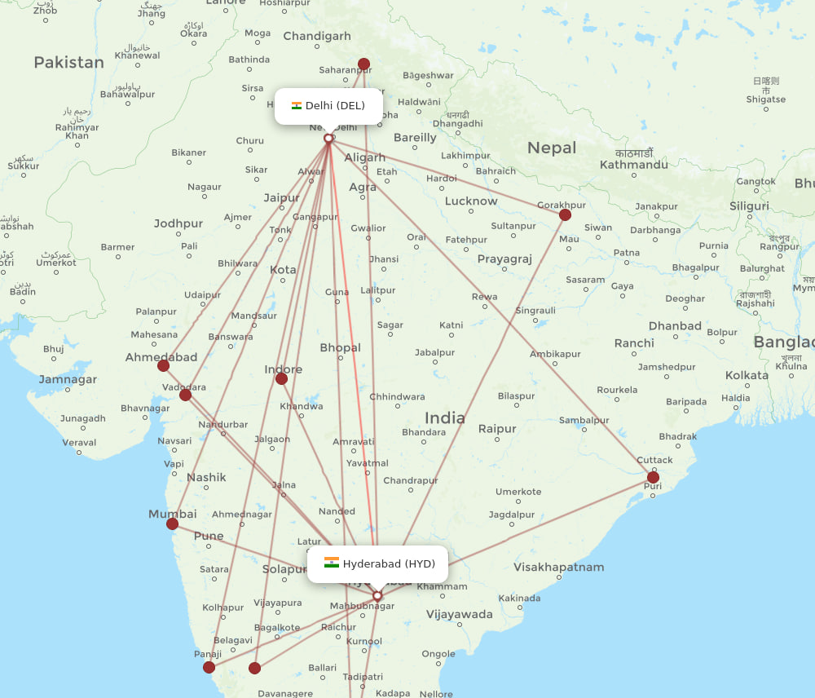
6.1.FEATURES
Available Routes:
Empowers users with informed decisions.
Offers multiple transportation options.
Includes buses, trains, flights, and local modes of transport.
Considers factors like budget, comfort, and travel time.
Enables travellers to select the most suitable route.

Slide 9
6.2.FEATURES
Dark Tourism:
It’s like finding hidden treasure opting for lesser known equally amazing spots that packs the same punch as popular destinations.
Think Pristine beaches, charming towns and breath taking landscapes minus the crowds.
Get set to uncover these hidden gems and brag about your off the beaten path discoveries.

Slide 10
6.3.FEATURES
Tourism Packages:
Many travellers struggle to find affordable transportation options to their desired destinations.
Offers bundled deals and discounts.
Choose a package tailored to preferences and interests.
Offers bundled deals and discounts.
Saves time and effort in individual booking arrangements.

Slide 11
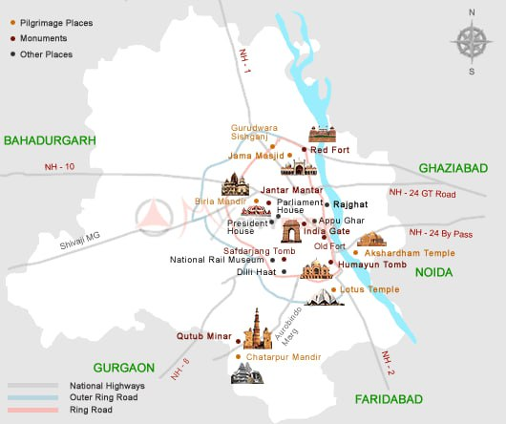
6.4.FEATURES
Audio Book:
Descriptive audio content highlighting the beauty of various destinations.
Engaging storytelling to evoke vivid imagery in listeners' minds.
Enhances the travel experience by providing a deeper understanding of destinations.
Provides valuable insights into local culture, history, and traditions through audio narration.

Slide 12
7. DESIGN
SKIP SIGN UP
SELECT LANGUAGE
SIGN UP

Slide 13
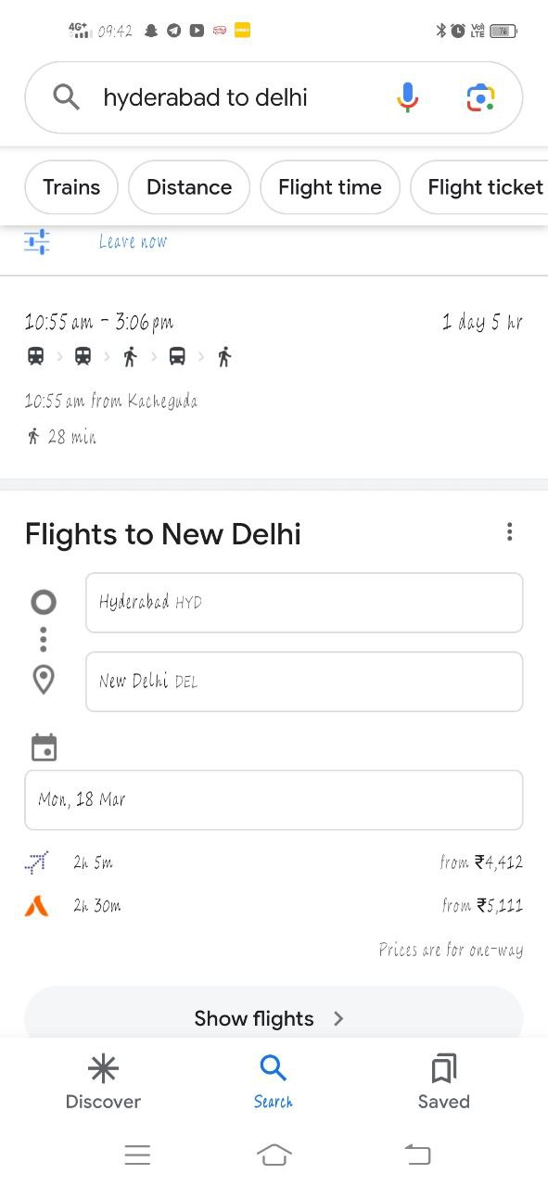



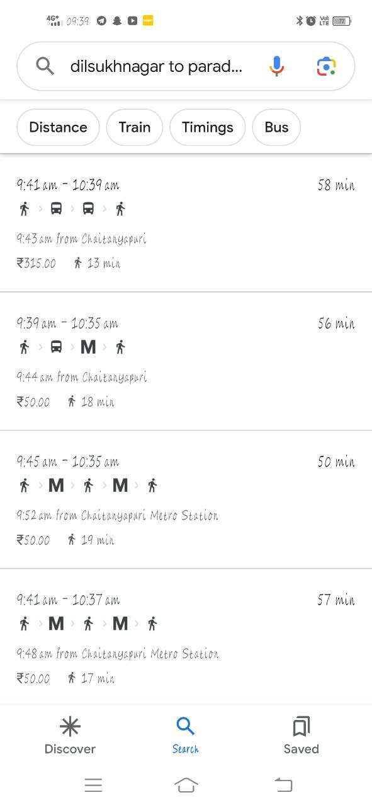



7.1.DESIGN
From
Hyderabad
To
Delhi
Date of Journey
Sun 25-Feb
Search Routes

Slide 14
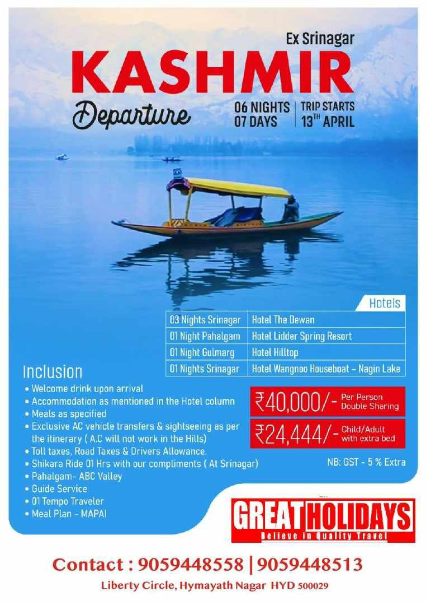
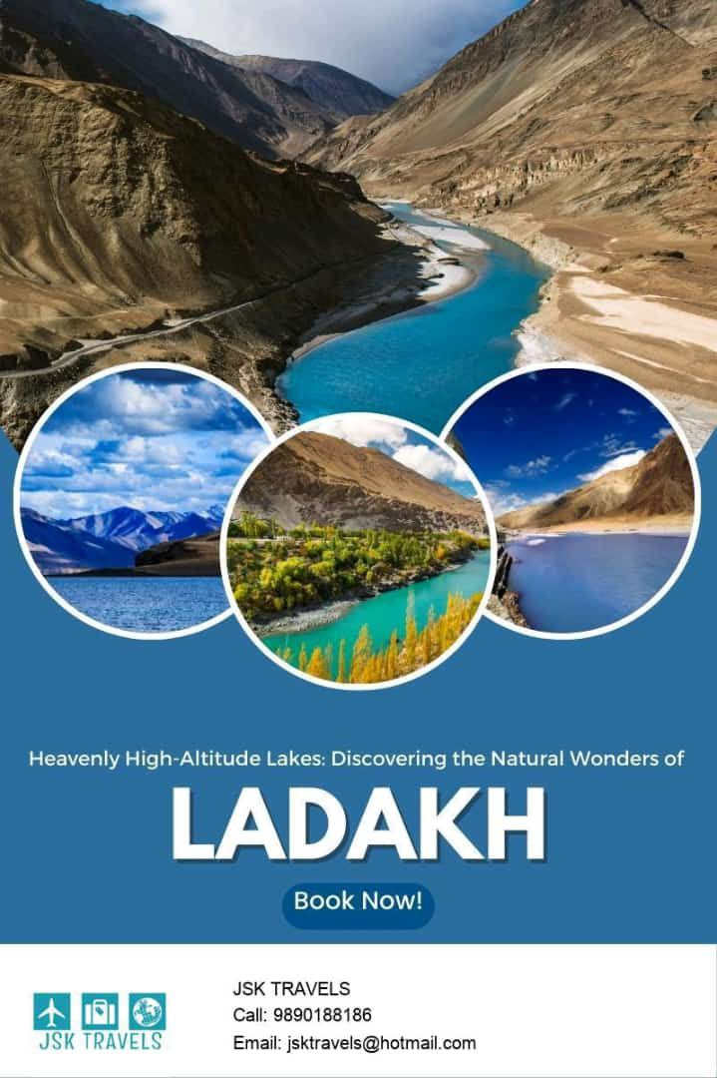
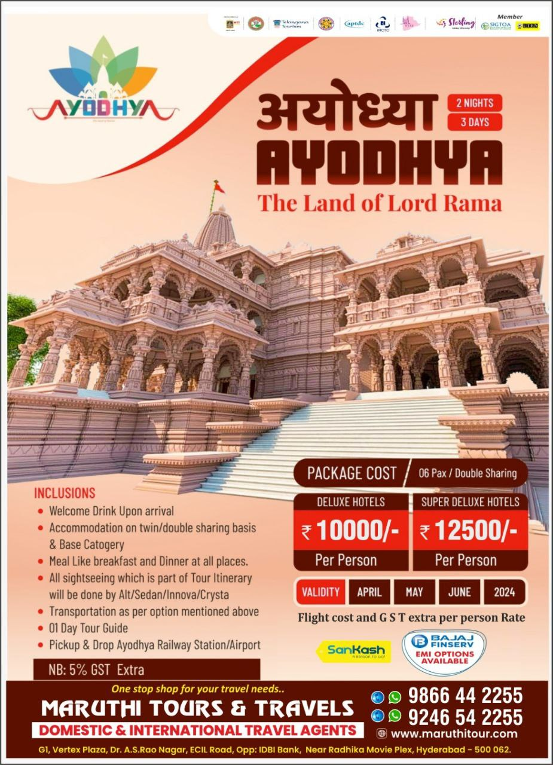
7.2.DESIGN

Slide 15
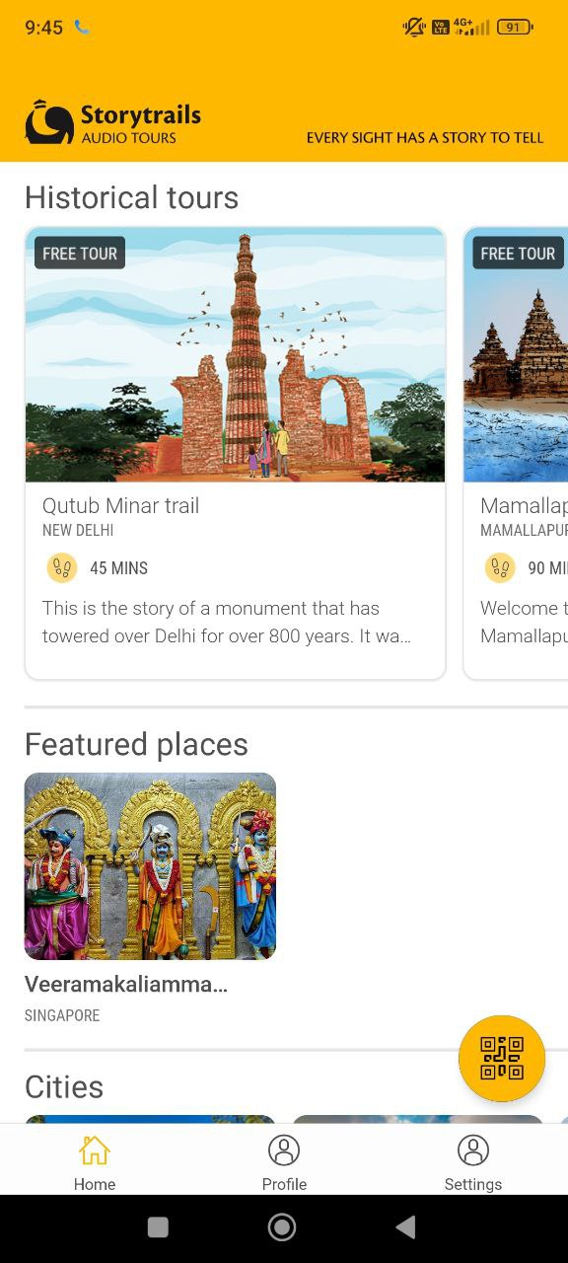
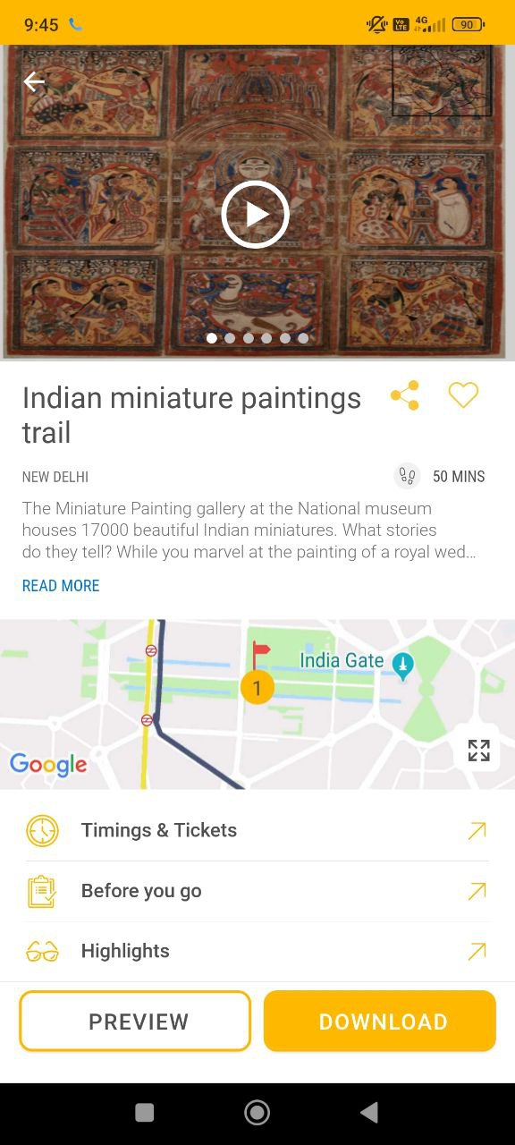
7.3.DESIGN

Slide 16
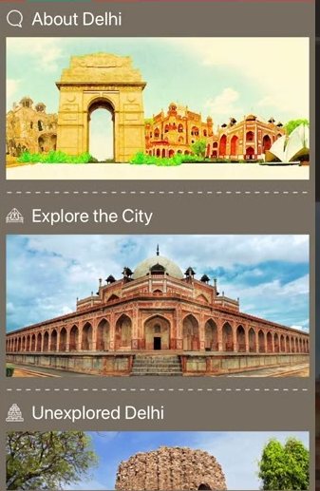
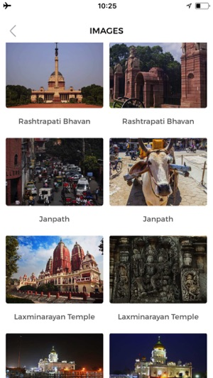
7.4.DESIGN

Slide 17
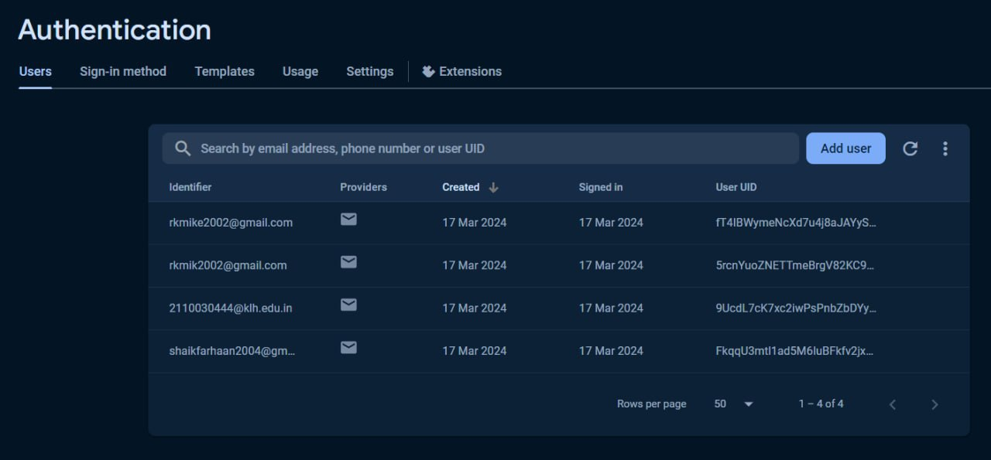
8. IMPLEMENTATION

Slide 18
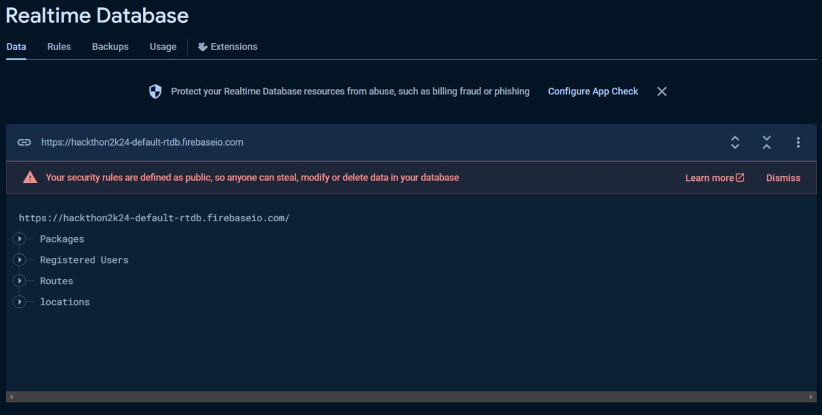
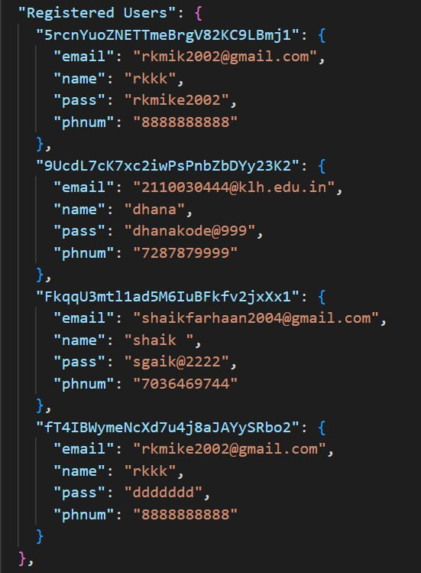
8.1.IMPLEMENTATION

Slide 19
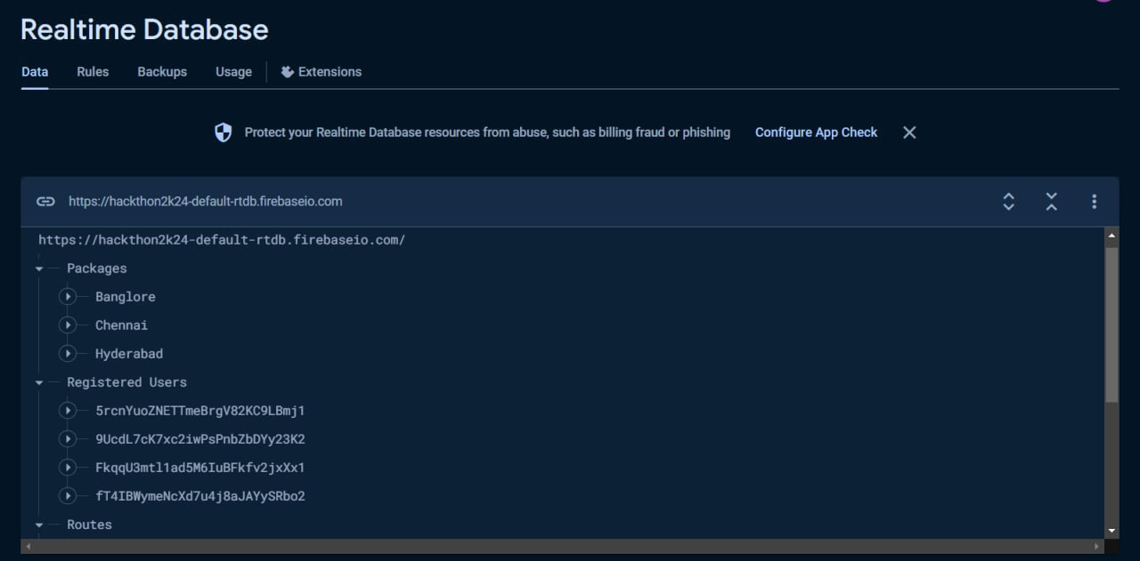
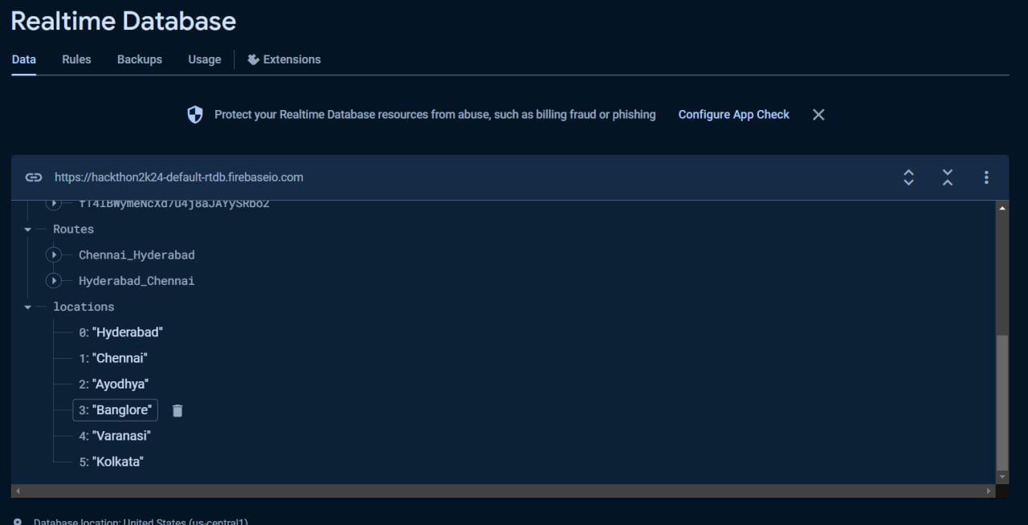
8.2.IMPLEMENTATION

Slide 20
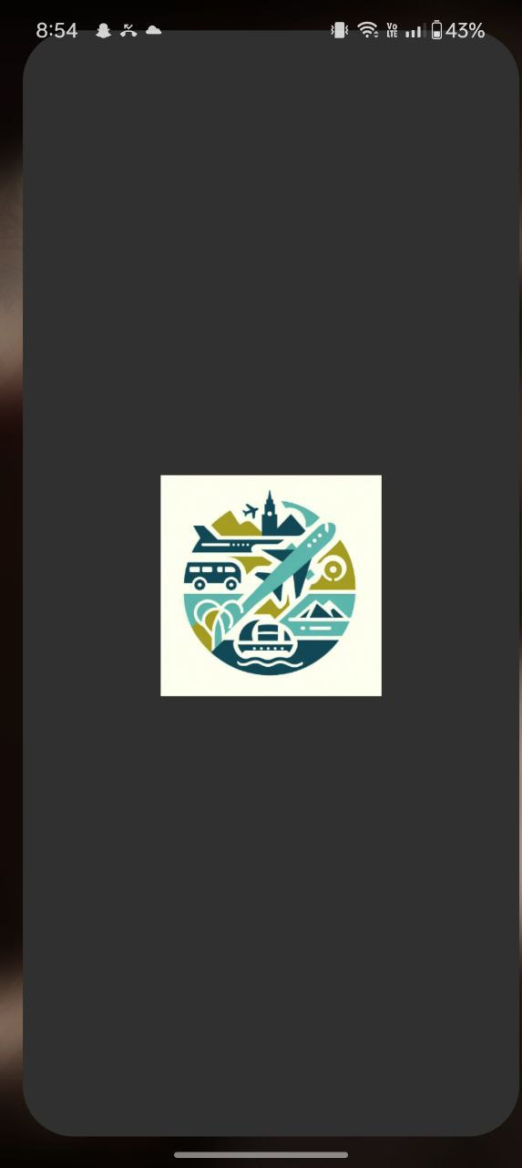
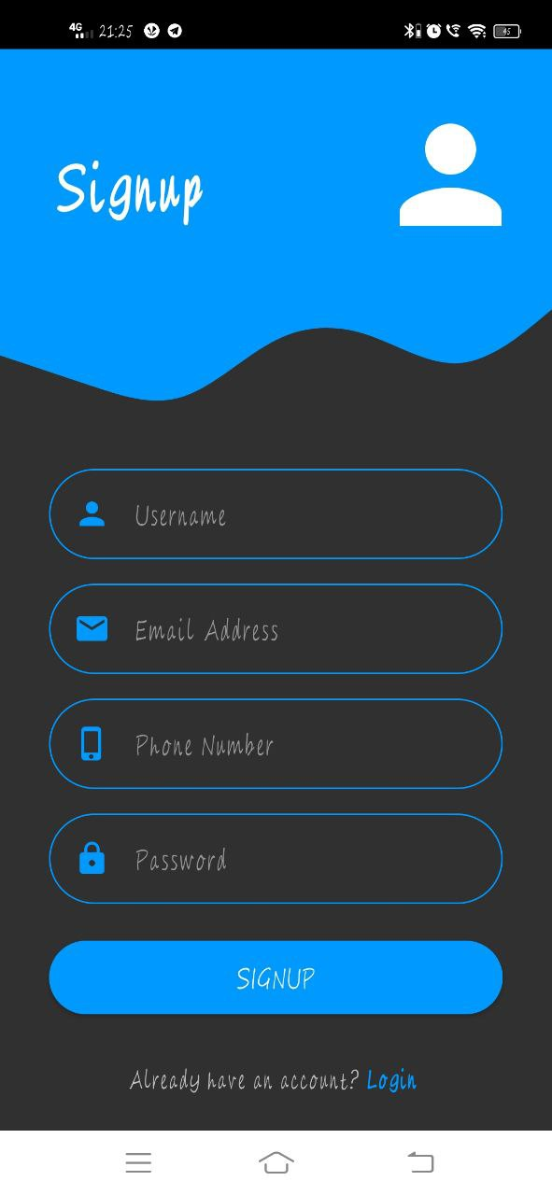
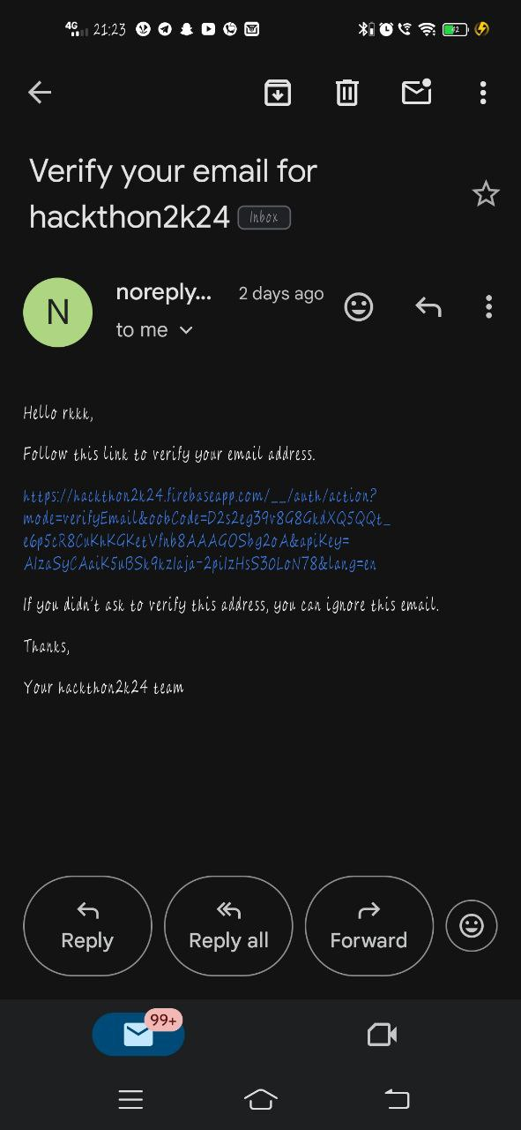
9. OUTPUT
SIGNUP
LOGIN
TRIP SPHERE

Slide 21
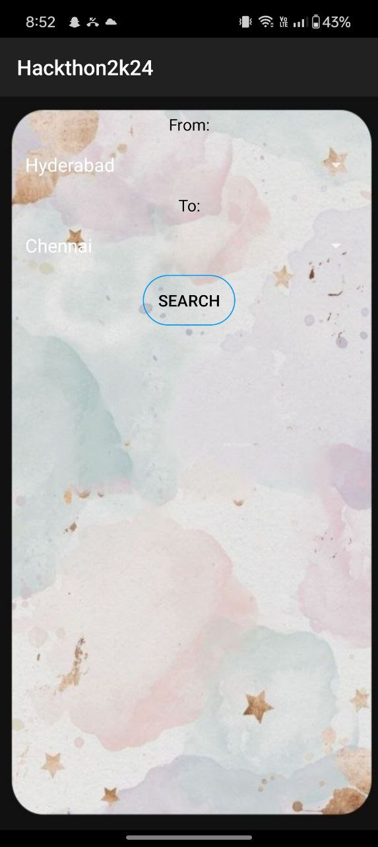
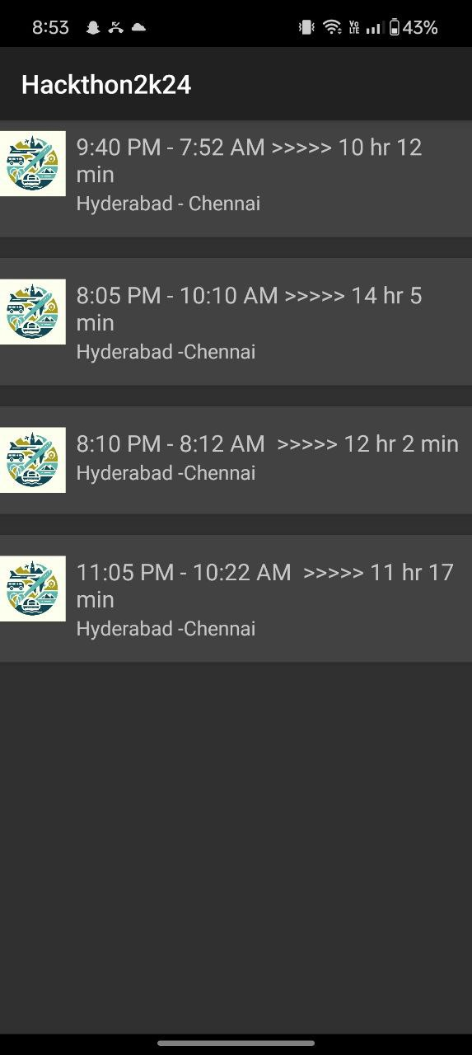
9.1.OUTPUT
SIGNUP
LOGIN
TRIP SPHERE

Slide 22
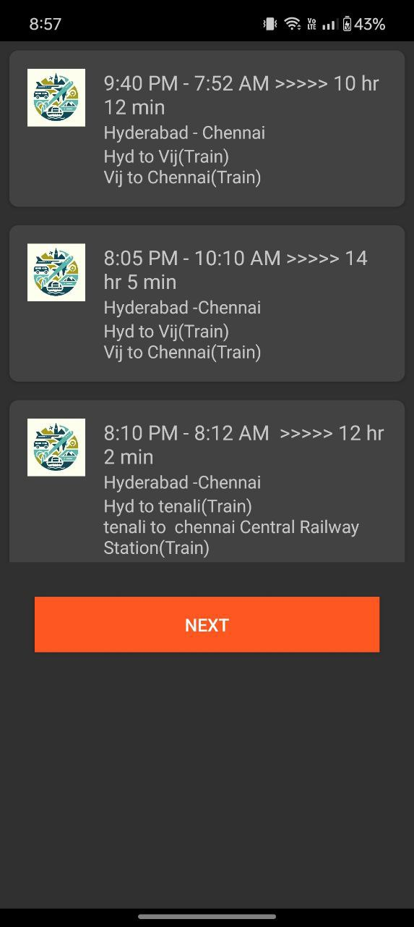
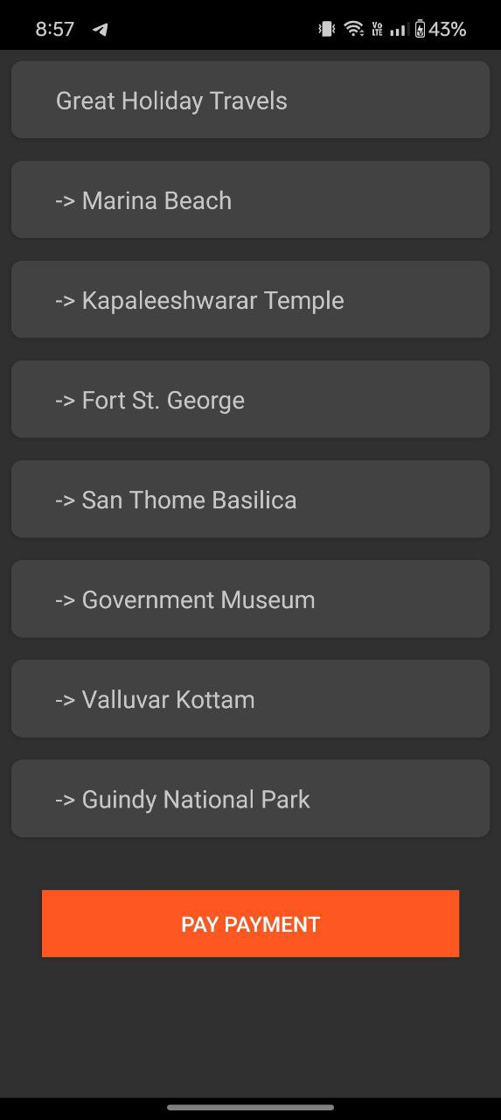
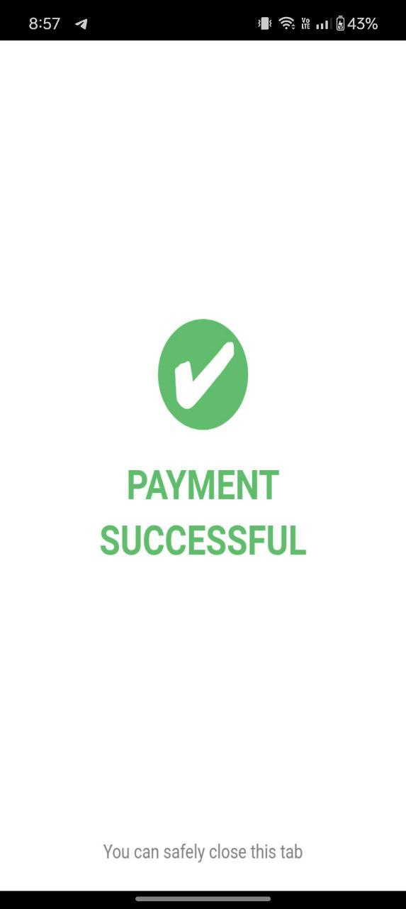
9.2.OUTPUT

Slide 23
10. FUTURE ENHANCEMENTS
Trip Sharing Platform:
Create a platform within the app where solo travelers can share their upcoming trips and connect with other travelers interested in joining them.
Feedback and Reviews:
Enable travelers to provide feedback and reviews after their trip, helping to improve the trip-sharing experience for future participants.
Develop a matching algorithm that pairs travelers based on their travel preferences, interests, and budget, ensuring compatibility and a positive travel experience.

Slide 24
11. CONCLUSION
An advanced route planning system and precise travel packages meet users' budget and time needs.
Enhances convenience and satisfaction for travelers exploring India's diverse landscapes.
Provides a platform for local agents to showcase offerings and promotes tourism.
Bridges travellers with local expertise, fostering economic growth and cultural exchange.

Slide 25


